Slide 1
Ggplot2 and interactive graphics with R
Christophe Ladroue
SECTION 04
VIDEO 03
User-defined functions
www.PacktPub.com

Slide 2
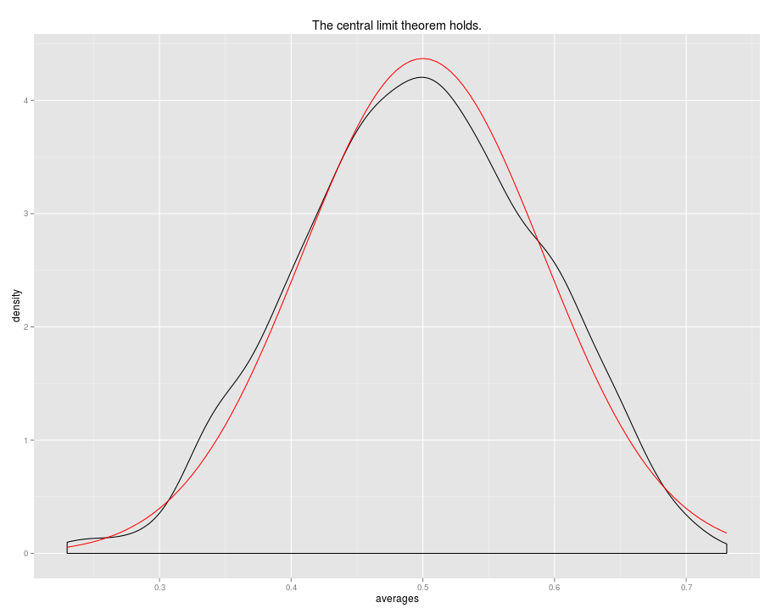
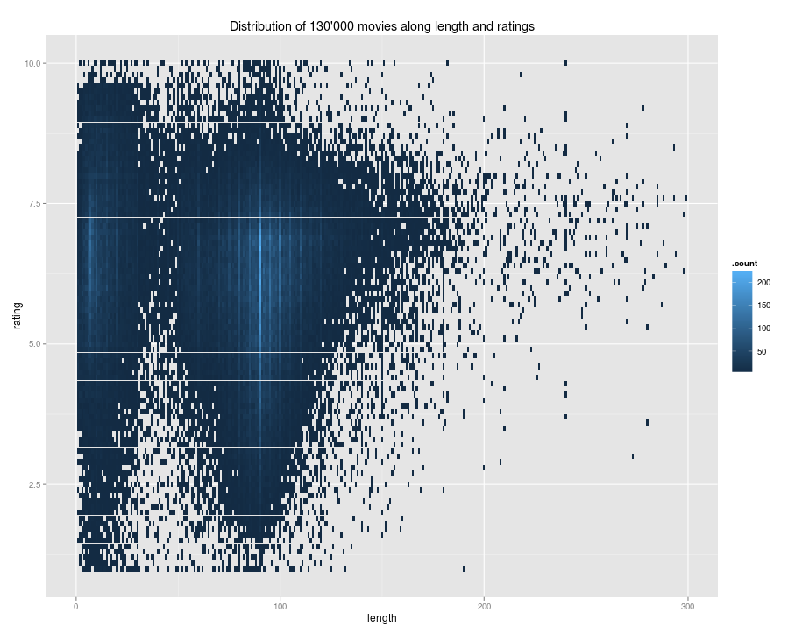
In this video we took a look at
how to add a user-defined function to a plot.
how to pass arguments to the user-defined function from ggplot.
Next: visualizing big datasets

